Slide 1
DeepRoad: GAN-Based Metamorphic Testing and Input
Validation Framework for Autonomous Driving Systems
A paper by Zhang et al.
Presented by Robin Dehler

Slide 2
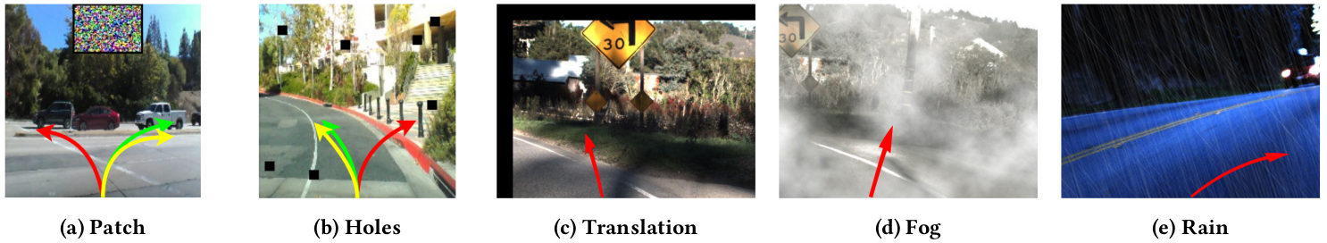
Introduction
DeepRoad, Robin Dehler
Safety aspect essential for AD systems
Prior work on testing AD systems have limitations
DeepRoad composed of
DeepRoad_{MT}
DeepRoad_{IV}

Slide 3
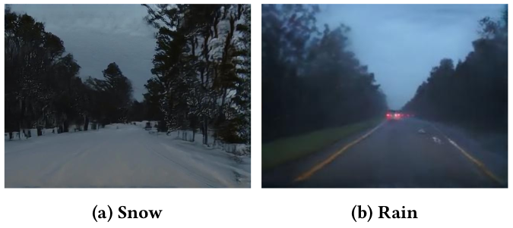
DeepRoad
DeepRoad, Robin Dehler
DeepRoad_{MT}
Develops metamorphic testing module
GAN-based technique
Testing of accuracy and reliability
DeepRoad_{IV}
VGGNet and PCA
Validates inputs by comparing distance

Slide 4
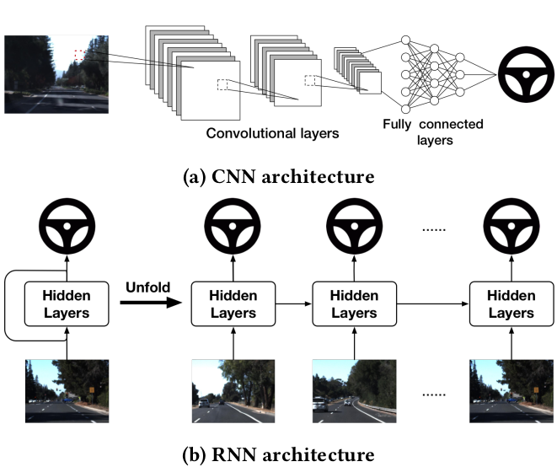
Revision: Network Architectures
DeepRoad, Robin Dehler
Convolutional Neural Networks
Convolutional layer as key component
Image processing with kernels
Allows weight sharing and can greatly save training effort
Recurrent Neural Networks
Models connections between frames
NN with feedback connections
Loops to forward the previous state to the input

Slide 5
Revision: Generative Adversarial Networks
DeepRoad, Robin Dehler
Aligns data distribution and model distribution
Main idea:
Draw samples (x) from data distribution (p_{data}) [i.e. real images]
Draw samples from model distribution (p_{g}) based on set of latent variables (z) drawn from a prior distribution (p_{z}) [i.e. generated (synthetic) images]
Detect samples coming from (p_{data}) with Discriminator network
Goal: p_{g} = p_{data} > Nash Equilibrium

Slide 6

Revision: GAN Training Process
DeepRoad, Robin Dehler
D classifies images into real or fake
G tries to fool model D
D acts as supervision on model G
No labels needed for training a GAN
Train discriminator (D) and generator (G) at the same time
Called adversarial training
G generates images from input noise
Src: https://www.google.com/url?sa=i&url=https%3A%2F%2Fwiki.pathmind.com%2Fgenerative-adversarial-network-gan&psig=AOvVaw2Uhayno0Dv-munrOzwp-Dz&ust=1636291852278000&source=images&cd=vfe&ved=0CAsQjRxqFwoTCOCR07rsg_QCFQAAAAAdAAAAABAi

Slide 7
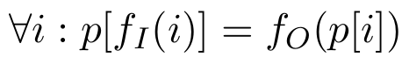
Metamorphic DNN Testing
DeepRoad, Robin Dehler
Test to detect software faults
Capable to solve the test oracle problem via Metamorph Relations
MR formulation:
MT: Testing p̂ via cross-checking inputs and outputs with MRs
Specific to problem of the paper:
DNN is the AD system that maps each image into a predicted steering angle signal

Slide 8
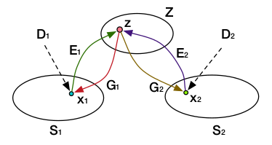
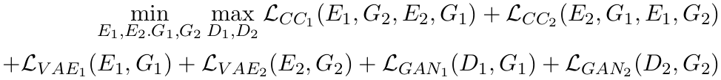
DNN-based Road Scene Transformation
DeepRoad, Robin Dehler
DeepTest also applied MT, but with limitations
DeepRoad complements DeepTest by leveraging UNIT
Unsupervised image-to-image trafo with GANs and VAEs
UNIT can transform image to another domain
Total loss is dependent on
VAE loss
GAN loss
Cycle-consistency loss
Optimization with SGD

Slide 9
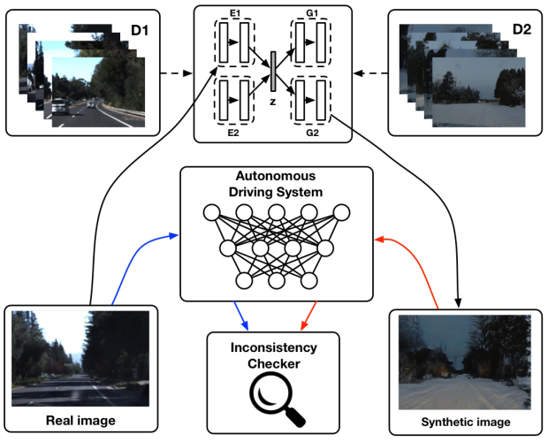
Framework for DeepRoad_{MT}
DeepRoad, Robin Dehler
Steps:
Take training images, utilize UNIT
Use well-trained model to transform set from sunny to snowy weather
Feed pairs to ADS and compare
Inconsistencies in steering angle indicate issues

Slide 10
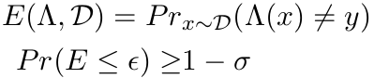
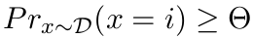
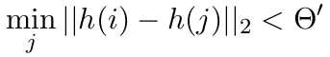
Input validation for DNN-based ADSs
DeepRoad, Robin Dehler
Goal: Accept only specific data as input
IV criteria with Probably Approximately Correct (PAC) Learning theory
Input data should be sampled from Ɗ with probability greater than threshold ϴ
Not suitable for image data
Use distance between projection of input & training data

Slide 11
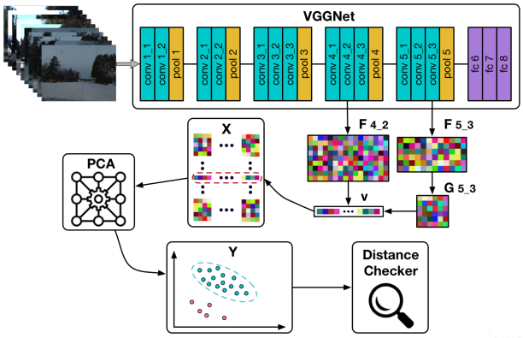
Framework for DeepRoad_{IV}
DeepRoad, Robin Dehler
h(.) does non-linear trafo and dimension reduction
Non-linear trafo
Apply VGGNet
Feature matrix F_{i} with size (N_{i},M_{i})
Generation of style information
Captures texture of image
Defined by feature correlation
Principle Component Analysis (PCA)
Reduces feature dimension of input and training data

Slide 12
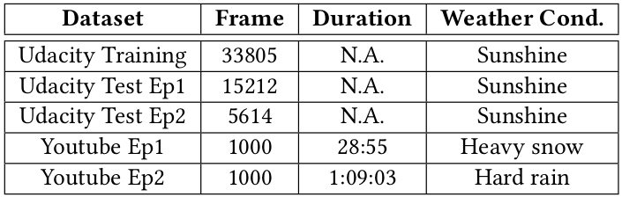
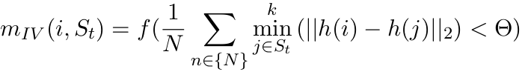
Experiment Setup
DeepRoad, Robin Dehler
Dataset
Udacity dataset + YouTube videos
320x240 + Downsampling for YT videos
Models
Autumn, Chauffeur, Rwightman
Metric
Steering angle prediction within certain bounds
number of inconsistent behaviors of ADSs
IV is minimal distance of input and training images
Limitations solved by

Slide 13
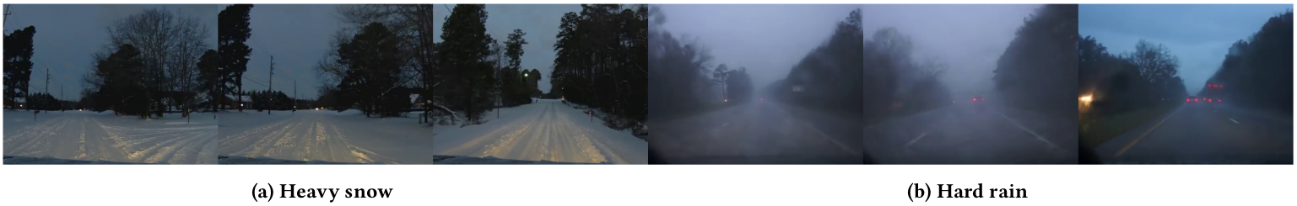
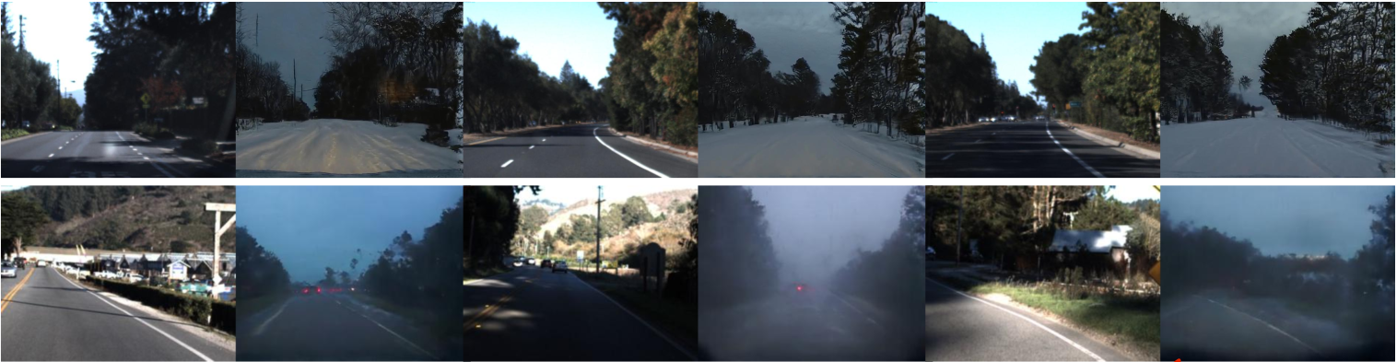
Results of DeepRoad_{MT}
DeepRoad, Robin Dehler
Images collected from YouTube
Real and GAN-generated images

Slide 14
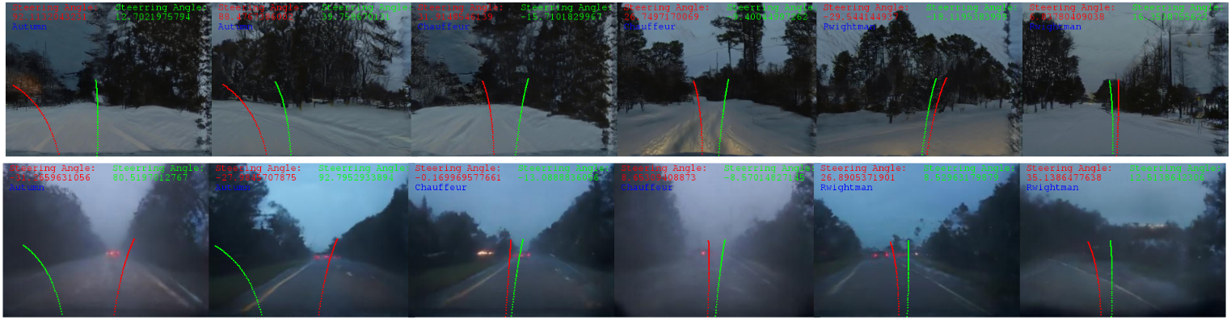
Results of DeepRoad_{MT}
DeepRoad, Robin Dehler
Inconsistency of steering angle prediction on real and synthetic images
Autumn
Chauffeur
Rwightman

Slide 15
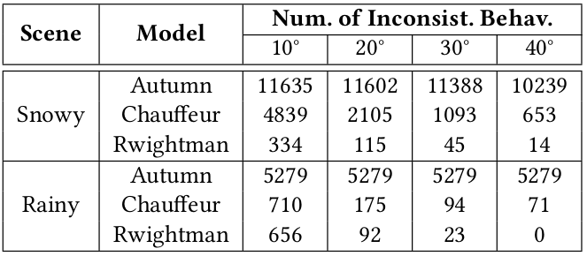
Results of DeepRoad_{MT}
DeepRoad, Robin Dehler
Overview of inconsistent behaviors
Autumn with most inconsistencies
Rwightman is the most stable

Slide 16
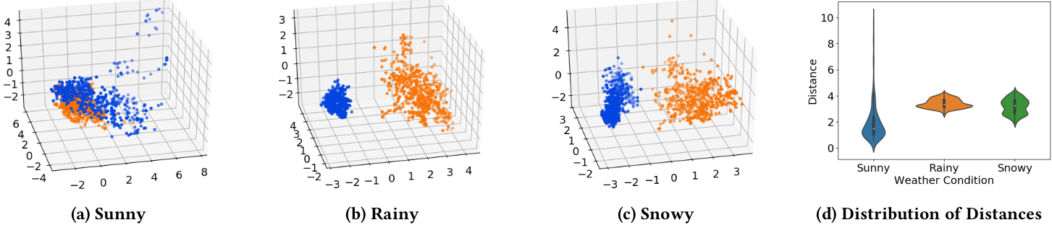
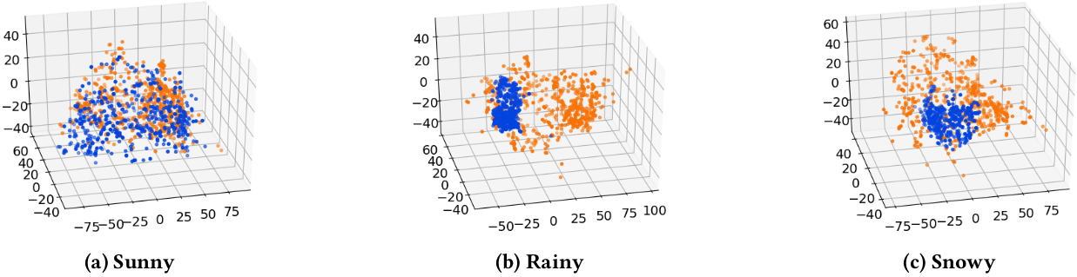
Results of DeepRaod_{IV}
DeepRoad, Robin Dehler
Image embeddings and distance distributions
Image embeddings without feature extraction

Slide 17
Threats to Validity
DeepRoad, Robin Dehler
Threats to internal validity
Potential defects in implementation
Reduced with UNIT and pre-trained VGG-Net weights
Threats to external validity
Lack of evaluation standard for image quality
Generation process of GANs is not controllable
Udacity is relatively small
No speed control

Slide 18
Conclusion
DeepRoad, Robin Dehler
“DeepRoad is an unsupervised learning framework to synthesize realistic driving scenes to test inconsistent behaviors of DNN-based autonomous driving systems and validate online input images to improve the system robustness.”
Experiments show that it can successfully detect inconsistent behaviors and improve system robustness.

